Slide 1



AI-Powered Smartwatch for Next-Gen Healthcare
Subtitle: Bridging wellness, AI, and real-time medical insights
Presented by: Deepak Patro
28th Aug 2025

Slide 2


Computing Components
Edge AI
Sensor Integration
CLOUD Sync
Storage & Memory

Slide 3
Executive Summary
Market Opportunity → Multi-billion dollar wearable health market.
Our Edge → Medical-grade accuracy + AI-driven insights + affordability.
Problem Solved → Gaps in early anomaly detection & proactive
health management.
Revenue Streams → Device sales, subscriptions, and B2B partnerships.

Slide 4
The Problem
1. Low Accuracy in Vitals Most consumer wearables provide only approximate readings for heart rate, SpO₂, or sleep patterns. They’re fine for fitness, but not reliable enough for clinical decision-making. This creates a trust gap for patients and doctors.
2. Limited Predictive Health Insights Current smartwatches are reactive they only display vitals. They don’t use AI to predict anomalies like arrhythmia, sleep apnea, or stress-related conditions. This means people often miss early warning signs that could prevent major health issues.
3. Lack of Healthcare Integration Wearables today are mostly consumer gadgets, not part of the medical ecosystem. Hospitals, insurers, and caregivers can’t access or trust the data, so there’s no end-to-end health management.
4. Consequence Users are left with raw numbers, not actionable health insights. This results in delayed detection of medical issues, higher treatment costs, and missed opportunities for preventive care.

Slide 5
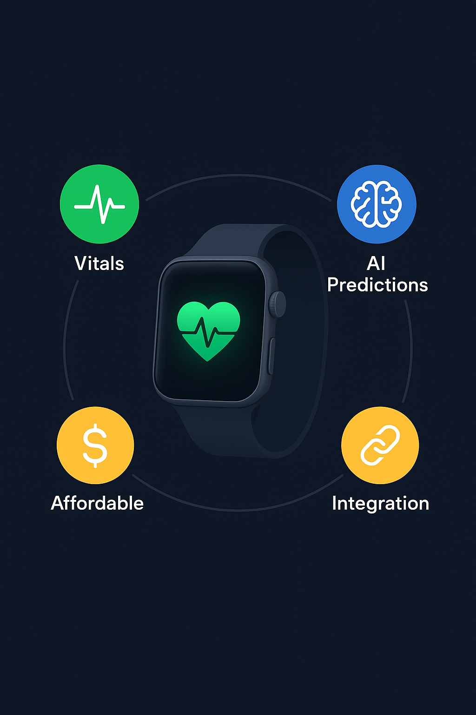
The Solution
Continuous Vitals Monitoring
Tracks heart rate, SpO₂, blood pressure, sleep cycles, stress levels.
Uses advanced sensors + AI calibration to reach medical-grade accuracy.
AI Models for Predictions
Anomaly detection: Early warning for arrhythmia, oxygen drops, irregular sleep patterns.
Mood & stress prediction: AI learns user behaviour → personalized mental wellness insights.
Sleep quality analysis: Identifies sleep debt, apnea risk, or irregular circadian rhythm.
Seamless Healthcare Integration
Doctors/Hospitals: Secure data sharing for remote monitoring.
Insurance companies: Preventive care → lower premiums for healthy habits.
Family/Caregivers: Alerts in emergencies.
Affordable & Scalable
Unlike high-cost medical devices, it’s priced for mass adoption.
Revenue model: Hardware sales + subscription AI insights + B2B partnerships.

Slide 6
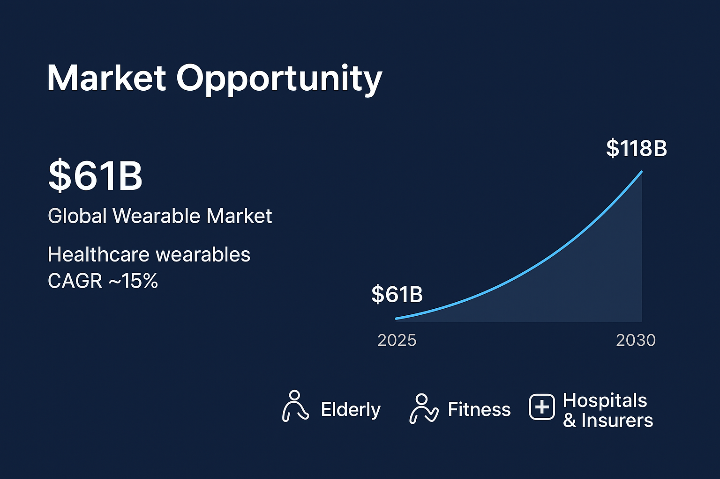
The wearable tech market is rapidly expanding — valued at $61B in 2025, projected to
nearly double to $118B by 2030.
Within that, healthcare wearables are the fastest-growing category, with a
15% CAGR (driven by preventive healthcare and aging populations).
Target Segments:
Elderly users who need chronic disease management and early anomaly detection.
Fitness enthusiasts who demand real-time performance optimization and AI insights.
Hospitals & insurers who are looking for continuous monitoring solutions for
better patient outcomes and cost savings.

Slide 7
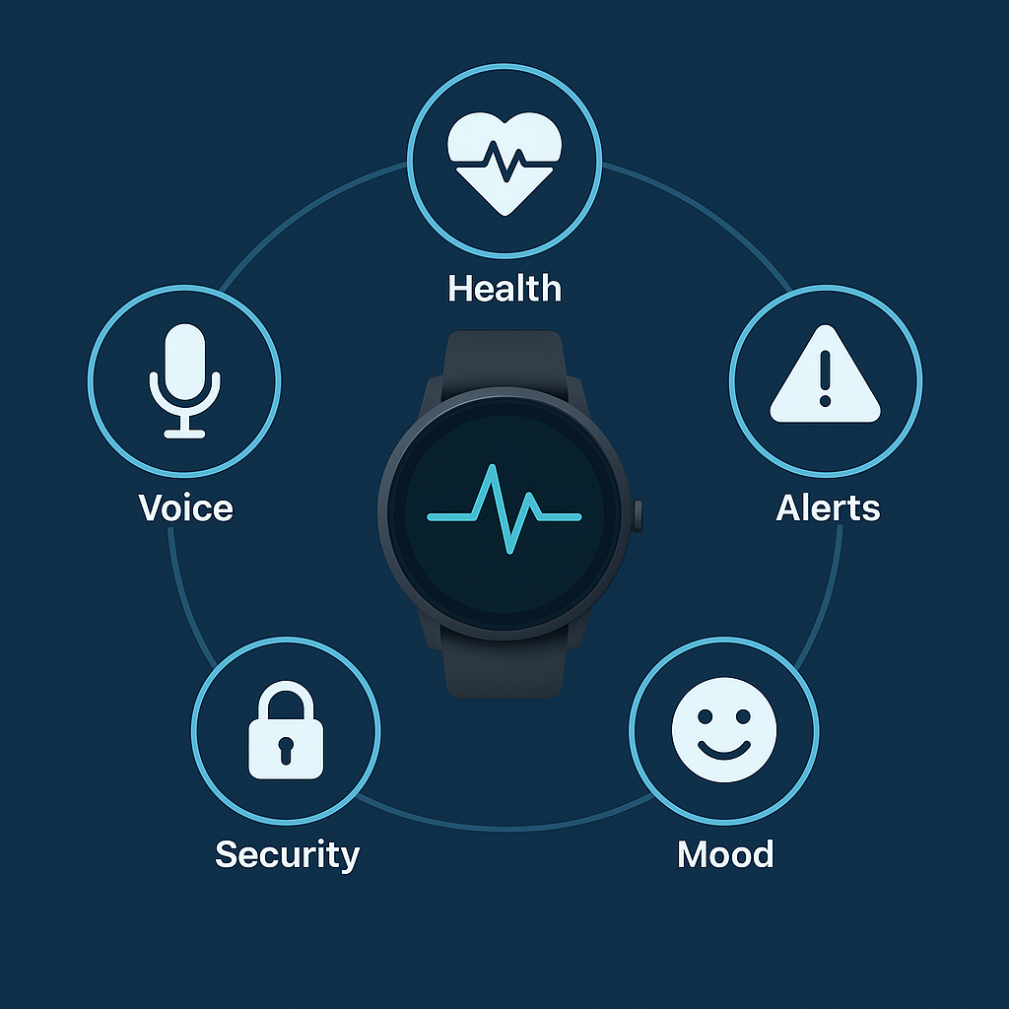
Product Features
🔹 Health Monitoring – Tracks ECG, HRV, SPO2, and sleep continuously, giving users real-time updates about their vital signs. This ensures preventive care, not just reactive.
🔹 Anomaly Alerts – AI models detect irregular heartbeats, respiratory risks, or other anomalies early and notify the user (and optionally caregivers/doctors).
🔹 Mood Prediction – Goes beyond physical health to monitor mental well-being. AI analyzes patterns (heart rate, HRV, sleep) to predict mood swings, stress, or depression signs.
🔹 Accessibility – Built-in voice assistant and multi-language support make it usable for elderly, differently-abled, and non-English-speaking populations.
🔹 Data Security – User health data is stored and transmitted with end-to-end encryption, making it safe for hospital and insurer integrations.

Slide 8
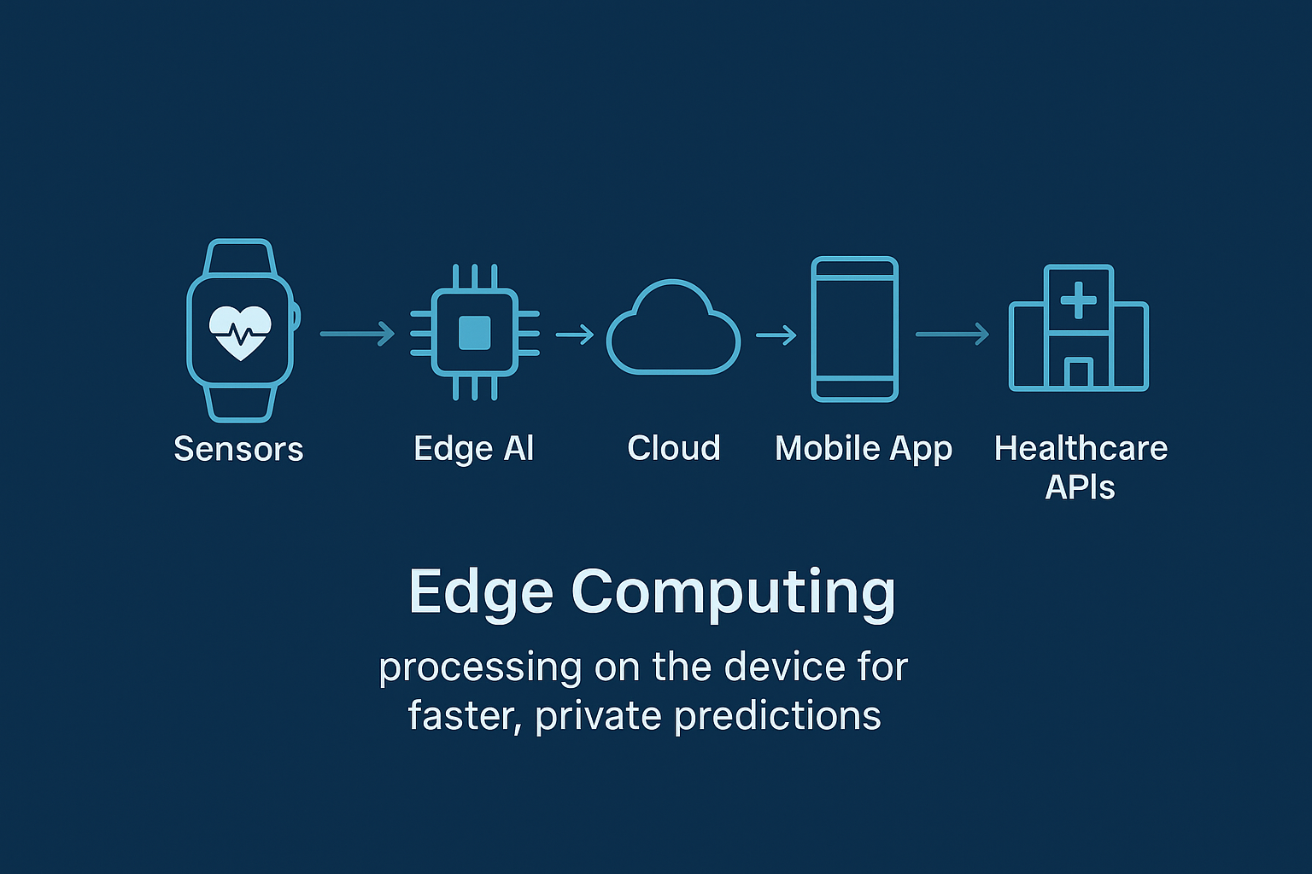
Technology Architecture

Slide 9
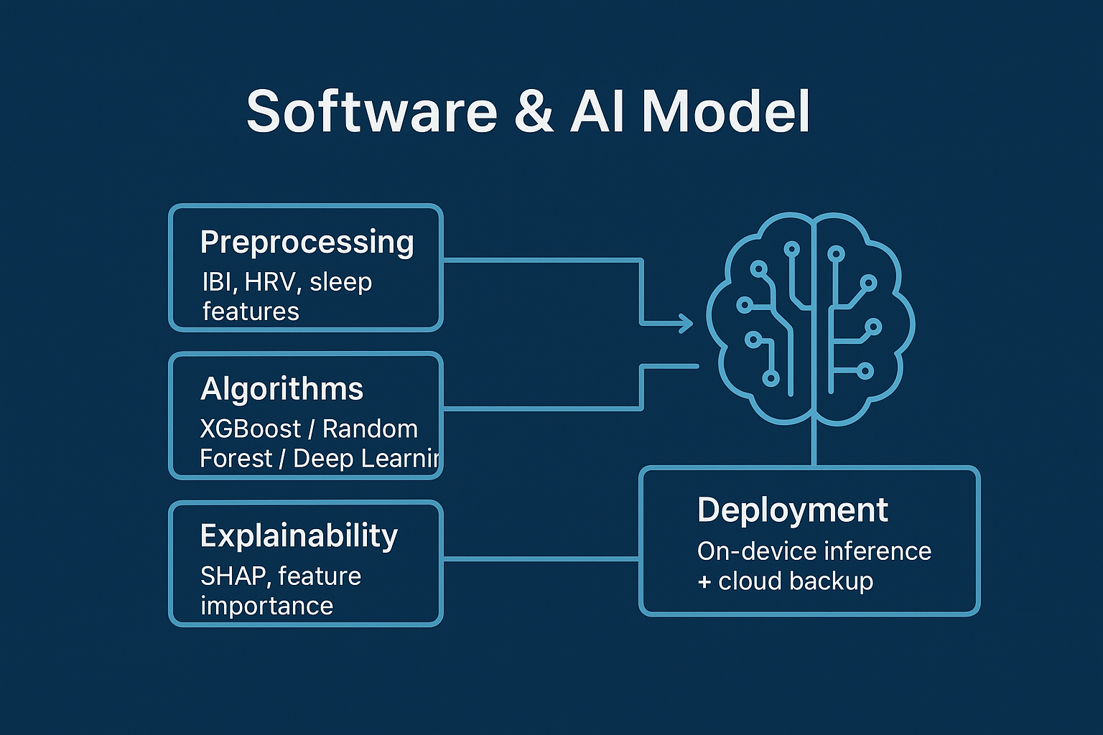
Pre-processing: IBI, HRV, sleep features.
Algorithms: XGBoost / Random Forest / Deep Learning.
Deployment: On-device inference + cloud backup.
Explain-ability: SHAP, feature importance.
Visual: Tech blocks with AI brain icon.
The pipeline = Raw sensor signals → feature extraction → AI algorithms → predictions on-device → backup + insights in the cloud → explainability for doctors & users.

Slide 10
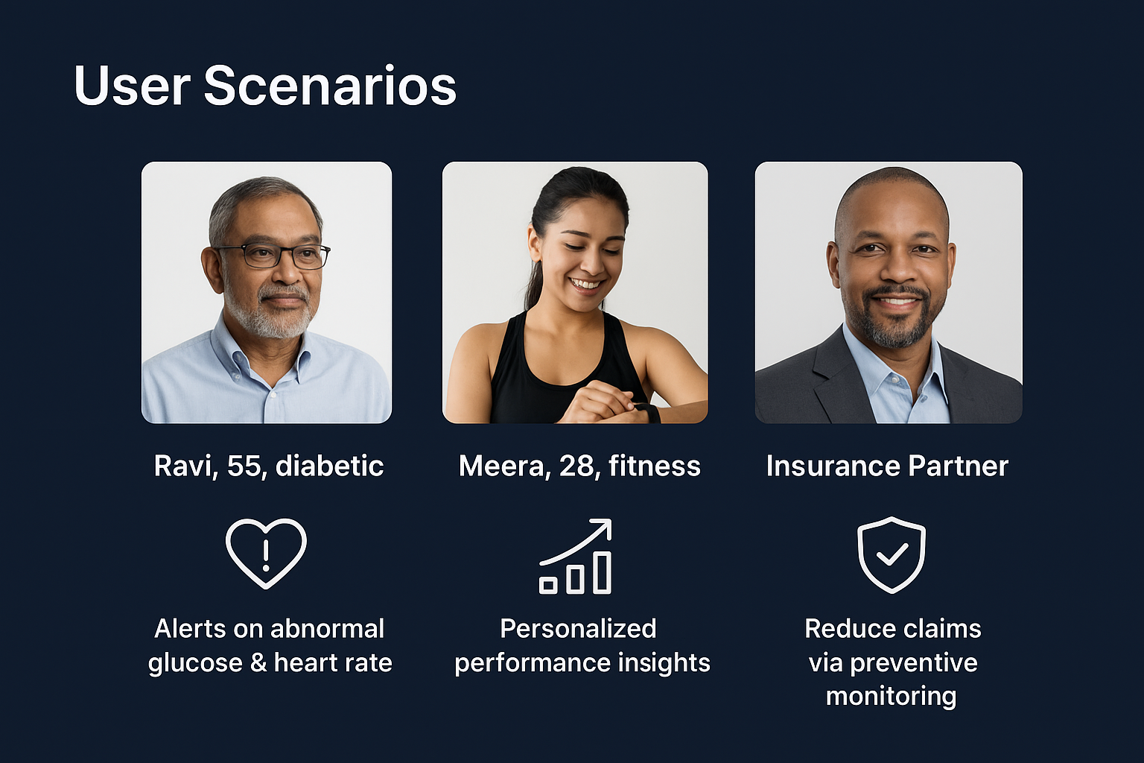
User Scenario
🔹 Meera (28, Fitness Enthusiast)
Need: Optimize workouts and recovery.
Scenario: The device tracks HRV, IBI, sleep quality, and exercise intensity.
Action: Provides personalized recommendations
like “Your recovery is low today, take a lighter workout.”
Benefit: Enhances performance and avoids overtraining.
🔹 Ravi (55, Diabetic Patient)
Need: Continuous health tracking for chronic condition.
Scenario: The smartwatch monitors Ravi’s heart rate and
glucose trends.
Action: If abnormal spikes/drops are detected, it sends an
instant alert to him and his caregiver/doctor.
Benefit: Prevents emergencies through early detection.
🔹 Insurance Partner
Need: Reduce claim risks and promote preventive healthcare.
Scenario: Partner integrates smartwatch data into wellness programs.
Action: Offers incentives (lower premiums, discounts) if users maintain good health metrics.
Benefit: Fewer hospitalizations → reduced claims → cost savings.

Slide 11
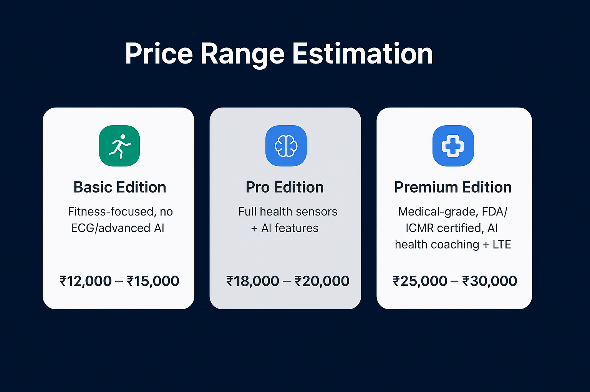
Price Range Estimation
Basic Edition (Fitness-focused, no ECG/advanced AI): ₹12,000 – ₹15,000 Pro Edition (Full health sensors + AI features): ₹18,000 – ₹20,000 Premium Edition (Medical-grade, FDA/ICMR certified, AI health coaching + LTE): ₹25,000 – ₹30,000

Slide 12
Revenue & Business Model
Primary Revenue (B2C – One-time)
Smartwatch Device Sales
Affordable pricing to capture mass adoption.
Hardware margins + bundled starter features.
Recurring Revenue (B2C – Ongoing)
Subscription for Premium AI Insights
Predictive health alerts, mood/mental wellness tracking, sports performance insights.
Tiered plans (Basic, Pro, Enterprise).
B2B Partnerships (Bulk / Institutional)
Hospitals → Remote patient monitoring.
Insurance Companies → Preventive health programs & claim reduction.
Wellness Programs / Corporates → Employee health benefits.

Slide 13
Competitive Landscape
Feature | Our Smartwatch | Apple Watch | Fitbit | Garmin
Medical Accuracy | ✅ | ❌ | ❌ | ❌
AI Predictions | ✅ | ❌ | ❌ | ❌
Price (Affordable) | ✅ | ❌ (High) | ✅ | ❌
Hospital Integration | ✅ | ❌ | ❌ | ❌

Slide 14
Future Scope
Integrate with Electronic Health Records (EHRs):
Sync smartwatch health data with hospitals and clinics for real-time monitoring.
Doctors can access patient vitals remotely, improving diagnosis and treatment.
Expansion into Elderly Care Facilities:
Special focus on elderly users for fall detection, medication reminders, and emergency alerts.
Helps care centers monitor multiple patients at once, ensuring safety and timely medical support.
Partnerships with Insurance Companies:
Health insurers can offer discounts or rewards to users who maintain good health metrics (steps, heart rate, sleep).
Builds a wellness ecosystem that encourages preventive healthcare.
Launch Premium Sports Edition for Athletes:
Advanced tracking features like VO₂ max, lactate threshold, recovery time, and performance analytics.
Tailored to professional and semi-professional athletes for training optimization.

Slide 15
Achievements & Milestones
Research Completed
Market research, competitor analysis, and user need assessments have been conducted.
Validated the demand for affordable, medically accurate AI smartwatch solutions.
Prototype Design (In Progress)
Hardware prototype design is underway, with core sensors and AI algorithms being integrated.
Focused on balancing accuracy, battery life, and affordability.
Next: Pilot with Hospital Partner
A real-world pilot program will be launched in collaboration with hospitals.
This phase will test medical accuracy, hospital integration, and user experience in clinical settings.
Scaling: Investor Funding for Mass Production
Once the pilot is successful, the next milestone is to secure investment.
Funding will enable mass production, marketing, and expansion into healthcare and consumer markets.

Slide 16
Business Collaboration Opportunities:
Tech Partners for Sensors & AI Integration
Collaborations with hardware sensor manufacturers (ECG, SpO2, BP) and AI software providers.
Helps improve medical accuracy, device reliability, and cloud integration.
Hospitals & Insurers for Trials & Distribution
Partnering with hospitals for clinical trials to validate medical-grade accuracy.
Collaborations with insurance companies to provide the smartwatch as part of wellness and preventive
healthcare plans.
Manufacturing Partners for Scaling
Working with large-scale manufacturers for cost-effective, high-quality production.
Ensures timely delivery when scaling from prototype to mass-market product.

Slide 17
Team & Expertise
Deepak Patro – Founder
Expertise: AI/ML, Data Science, Product Vision
Previous experience in data-driven product development, sales, and analytics.
Focus: Turning health-tech innovation into real-world adoption.
🤝 Open for Strategic Partnerships
Looking for collaborations with tech, healthcare, insurance, and manufacturing partners.

Slide 18
Closing / Call to Action
💡 Vision Empowering healthcare with affordable AI-driven wearables for every individual.
Our Ask
💰 Funding to scale prototype → pilot → mass production.
🤝 Strategic partnerships with hospitals, insurers, and manufacturing leaders.
🙏 Thank You
📞 Contact Info
Name: Deepak Patro
Role: Founder – AI/ML, Data Science & Product Vision
Email: [deepakpatro73@gmail.com]
Phone: [+918114702933]

